Slide 1
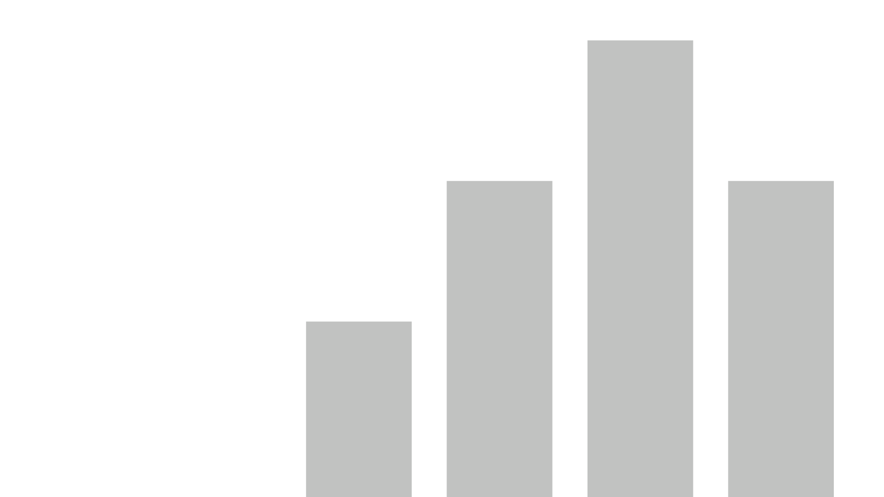


CatsVsDogs
View in Power BI
Last data refresh:
5/7/2023 9:57:04 AM UTC
Downloaded at:
5/7/2023 10:06:45 AM UTC

Slide 2
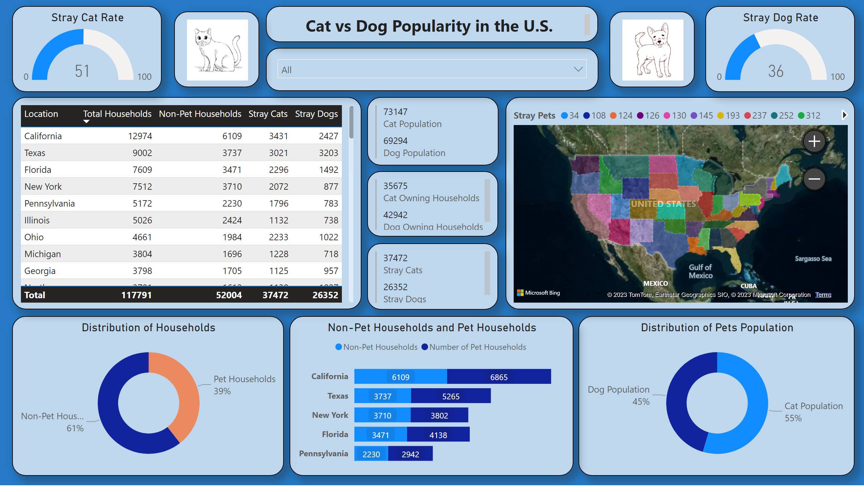
Page 1
Notes:
Distribution of Households
No alt text provided
Percentage of households with pets
No alt text provided
Distribution of Pets Population
No alt text provided
filledMap
No alt text provided
Stray Cat Rate
No alt text provided
Stray Dog Rate
No alt text provided
multiRowCard
No alt text provided
multiRowCard
No alt text provided
multiRowCard
No alt text provided
slicer
No alt text provided
Non-Pet Households and Pet Households
No alt text provided
textbox
No alt text provided
image
No alt text provided
image
No alt text provided

